Slide 1
Deriving Time Complexity

Slide 2
Algorithms for computing the Factorial
int factorial (int n)
{
if (n<=1)
return 1;
else {
fact = 1;
for (k=2; k<=n; k++)
fact *= k;
return fact;
}
}
int factorial (int n)
{
If (n <= 1)
return 1;
else
return n *factorial(n-1);
}

Slide 3
Function()
{
int I,j,k;
for(i=1 to n)
for(j=1 to n)
for(k=1 to n)
print(“Hello”);
}
}
Function()
{
int I;
for(i=1 to n)
print(“Hello”);
}
}
Function()
{
int I,j;
for(i=1 to n)
for(j=1 to n)
print(“Hello”);
}
}
O(n) O(n²) O(n³)

Slide 4
function(){
int i=1, s=1;
while(s<=n)
{
i++;
s=s+i;
printf(“hello”)
}
}
S
i

Slide 5
function(){
int i=1, s=1;
while(S<=n)
{
i++;
s=s+i;
printf(“hello”)
}
}
S
i 1

Slide 6
function(){
int i=1, s=1;
while(S<=n)
{
i++;
s=s+i;
printf(“hello”)
}
}
S 1
i 1

Slide 7
function(){
int i=1, s=1;
while(S<=n)
{
i++;
s=s+i;
printf(“hello”)
}
}
S 1
i 1 2

Slide 8
function(){
int i=1, s=1;
while(S<=n)
{
i++;
s=s+i;
printf(“hello”)
}
}
S 1 3
i 1 2

Slide 9
function(){
int i=1, s=1;
while(S<=n)
{
i++;
s=s+i;
printf(“hello”)
}
}
S 1 3
i 1 2 3

Slide 10
function(){
int i=1, s=1;
while(S<=n)
{
i++;
s=s+i;
printf(“hello”)
}
}
S 1 3 6
i 1 2 3

Slide 11
function(){
int i=1, s=1;
while(S<=n)
{
i++;
s=s+i;
printf(“hello”)
}
}
S 1 3 6
i 1 2 3 4

Slide 12
function(){
int i=1, s=1;
while(S<=n)
{
i++;
s=s+i;
printf(“hello”)
}
}
S 1 3 6 10
i 1 2 3 4

Slide 13
function(){
int i=1, s=1;
while(S<=n)
{
i++;
s=s+i;
printf(“hello”)
}
}
S 1 3 6 10
i 1 2 3 4 5

Slide 14
function(){
int i=1, s=1;
while(S<=n)
{
i++;
s=s+i;
printf(“hello”)
}
}
S 1 3 6 10 15
i 1 2 3 4 5

Slide 15
function(){
int i=1, s=1;
while(S<=n)
{
i++;
s=s+i;
printf(“hello”)
}
}
S 1 3 6 10 15
i 1 2 3 4 5 6

Slide 16
function(){
int i=1, s=1;
while(S<=n)
{
i++;
s=s+i;
printf(“hello”)
}
}
S 1 3 6 10 15 21
i 1 2 3 4 5 6

Slide 17
function(){
int i=1, s=1;
while(S<=n)
{
i++;
s=s+i;
printf(“hello”)
}
}
S 1 3 6 10 15 21
i 1 2 3 4 5 6.........n

Slide 18
function(){
int i=1, s=1;
while(s<=n)
{
i++;
s=s+i;
printf(“hello”)
}
}
S 1 3 6 10 15 21……n(n+1)/2
i 1 2 3 4 5 6.........n

Slide 19

function(){
int i=1, s=1;
while(s<=n)
{
i++;
s=s+i;
printf(“hello”)
}
}
S 1 3 6 10 15 21……n(n+1)/2
i 1 2 3 4 5 6.........k
K(K+1)/2 >=n
(K²+k)/2>=n
Which means $K^{2}=n$
k =$\sqrt{n}$ ie O($\sqrt{n}$)

Slide 20
Function(){
i=1;
for(i=1;i²<=n;i++)
printf(“hello”);
}

Slide 21

Function(){
i=1;
for(i=1;i²<=n;i++)
printf(“hello”);
}
$$i^{2}≤n$$
or$i= \sqrt{n}$

Slide 22
P=0
For(i=0; P<n;i++)
P=P+i;
Assume P>n

Slide 23

P=0
For(i=0; P<n;i++)
P=P+i;
Assume p>n
i : 0 1 2 3 4 k
P : 0 0+1 1+2 1+2+3 1+2+3+4 1+2+…+k
K(k+1)/2 > n
K² > n
K> $\sqrt{n}$ O($\sqrt{n}$)

Slide 24
For(i=0;i<n;i++)
For(j=0; j<i;j++)
{
statement1;
}

Slide 25
For(i=0;i<n;i++)
For(j=0; j<i;j++)
{
statement1;
}

Slide 26
For(i=0;i<n;i++)
For(j=0; j<i;j++)
{
statement1;
}
I 0 1 2 3 …………. n
J 0 0 0..1 0..2 0..n-1
No.of times :0 1 2 3 n
N(n+1)/2 = O(n²)

Slide 27
Function(){
int I,j,k,n;
for(i=1;i<=n;i++){
for(j=1;j<=i;j++){
for(k=1;k<=100;k++){
print(“Hello”);
}
}
}
}
I
J
K

Slide 28
Function(){
int I,j,k,n;
for(i=1;i<=n;i++){
for(j=1;j<=i;j++){
for(k=1;k<=100;k++){
print(“Hello”);
}
}
}
}
I 1
J
K

Slide 29
Function(){
int I,j,k,n;
for(i=1;i<=n;i++){
for(j=1;j<=i;j++){
for(k=1;k<=100;k++){
print(“Hello”);
}
}
}
}
I 1
J 1
K

Slide 30
Function(){
int I,j,k,n;
for(i=1;i<=n;i++){
for(j=1;j<=i;j++){
for(k=1;k<=100;k++){
print(“Hello”);
}
}
}
}
I 1
J 1
K 1*100

Slide 31
Function(){
int I,j,k,n;
for(i=1;i<=n;i++){
for(j=1;j<=i;j++){
for(k=1;k<=100;k++){
print(“Hello”);
}
}
}
}
I 1 2
J 1
K 1*100

Slide 32
Function(){
int I,j,k,n;
for(i=1;i<=n;i++){
for(j=1;j<=i;j++){
for(k=1;k<=100;k++){
print(“Hello”);
}
}
}
}
I 1 2
J 1 2
K 1*100

Slide 33
Function(){
int I,j,k,n;
for(i=1;i<=n;i++){
for(j=1;j<=i;j++){
for(k=1;k<=100;k++){
print(“Hello”);
}
}
}
}
I 1 2
J 1 2
K 1*100 2*100

Slide 34
Function(){
int I,j,k,n;
for(i=1;i<=n;i++){
for(j=1;j<=i;j++){
for(k=1;k<=100;k++){
print(“Hello”);
}
}
}
}
I 1 2 3
J 1 2
K 1*100 2*100

Slide 35
Function(){
int I,j,k,n;
for(i=1;i<=n;i++){
for(j=1;j<=i;j++){
for(k=1;k<=100;k++){
print(“Hello”);
}
}
}
}
I 1 2 3
J 1 2 3
K 1*100 2*100

Slide 36
Function(){
int I,j,k,n;
for(i=1;i<=n;i++){
for(j=1;j<=i;j++){
for(k=1;k<=100;k++){
print(“Hello”);
}
}
}
}
I 1 2 3
J 1 2 3
K 1*100 2*100 3*100

Slide 37
Function(){
int I,j,k,n;
for(i=1;i<=n;i++){
for(j=1;j<=i;j++){
for(k=1;k<=100;k++){
print(“Hello”);
}
}
}
}
I 1 2 3 4
J 1 2 3
K 1*100 2*100 3*100

Slide 38
Function(){
int I,j,k,n;
for(i=1;i<=n;i++){
for(j=1;j<=i;j++){
for(k=1;k<=100;k++){
print(“Hello”);
}
}
}
}
I 1 2 3 4
J 1 2 3 4
K 1*100 2*100 3*100

Slide 39
Function(){
int I,j,k,n;
for(i=1;i<=n;i++){
for(j=1;j<=i;j++){
for(k=1;k<=100;k++){
print(“Hello”);
}
}
}
}
I 1 2 3 4
J 1 2 3 4
K 1*100 2*100 3*100 4*100

Slide 40
Function(){
int I,j,k,n;
for(i=1;i<=n;i++){
for(j=1;j<=i;j++){
for(k=1;k<=100;k++){
print(“Hello”);
}
}
}
}
I 1 2 3 4 5
J 1 2 3 4
K 1*100 2*100 3*100 4*100

Slide 41
Function(){
int I,j,k,n;
for(i=1;i<=n;i++){
for(j=1;j<=i;j++){
for(k=1;k<=100;k++){
print(“Hello”);
}
}
}
}
I 1 2 3 4 5
J 1 2 3 4 5
K 1*100 2*100 3*100 4*100

Slide 42
Function(){
int I,j,k,n;
for(i=1;i<=n;i++){
for(j=1;j<=i;j++){
for(k=1;k<=100;k++){
print(“Hello”);
}
}
}
}
I 1 2 3 4 5
J 1 2 3 4 5
K 1*100 2*100 3*100 4*100 5*100

Slide 43
Function(){
int I,j,k,n;
for(i=1;i<=n;i++){
for(j=1;j<=i;j++){
for(k=1;k<=100;k++){
print(“Hello”);
}
}
}
}
I 1 2 3 4 5…………….n
J 1 2 3 4 5
K 1*100 2*100 3*100 4*100 5*100

Slide 44
Function(){
int I,j,k,n;
for(i=1;i<=n;i++){
for(j=1;j<=i;j++){
for(k=1;k<=100;k++){
print(“Hello”);
}
}
}
}
I 1 2 3 4 5…………….n
J 1 2 3 4 5…………….n
K 1*100 2*100 3*100 4*100 5*100

Slide 45
Function(){
int I,j,k,n;
for(i=1;i<=n;i++){
for(j=1;j<=i;j++){
for(k=1;k<=100;k++){
print(“Hello”);
}
}
}
}
I 1 2 3 4 5…………….n
J 1 2 3 4 5…………….n
K 1*100 2*100 3*100 4*100 5*100…….n*100

Slide 46
Function(){
int I,j,k,n;
for(i=1;i<=n;i++){
for(j=1;j<=i;j++){
for(k=1;k<=100;k++){
print(“Hello”);
}
}
}
}
I 1 2 3 4 5…………….n
J 1 2 3 4 5…………….n
K 1*100 2*100 3*100 4*100 5*100…….n
1*100+2*100+3*100+4*100+……n*100

Slide 47
Function(){
int I,j,k,n;
for(i=1;i<=n;i++){
for(j=1;j<=i;j++){
for(k=1;k<=100;k++){
print(“Hello”);
}
}
}
}
I 1 2 3 4 5…………….n
J 1 2 3 4 5…………….n
K 1*100 2*100 3*100 4*100 5*100…….n
1*100+2*100+3*100+4*100+……n*100
100(1+2+3+4+……………n)

Slide 48
Function(){
int I,j,k,n;
for(i=1;i<=n;i++){
for(j=1;j<=i;j++){
for(k=1;k<=100;k++){
print(“Hello”);
}
}
}
}
I 1 2 3 4 5…………….n
J 1 2 3 4 5…………….n
K 1*100 2*100 3*100 4*100 5*100…….n * 100
1*100+2*100+3*100+4*100+……n*100
100(1+2+3+4+……………n)
n(n+1)/2 ie O(n²)

Slide 49
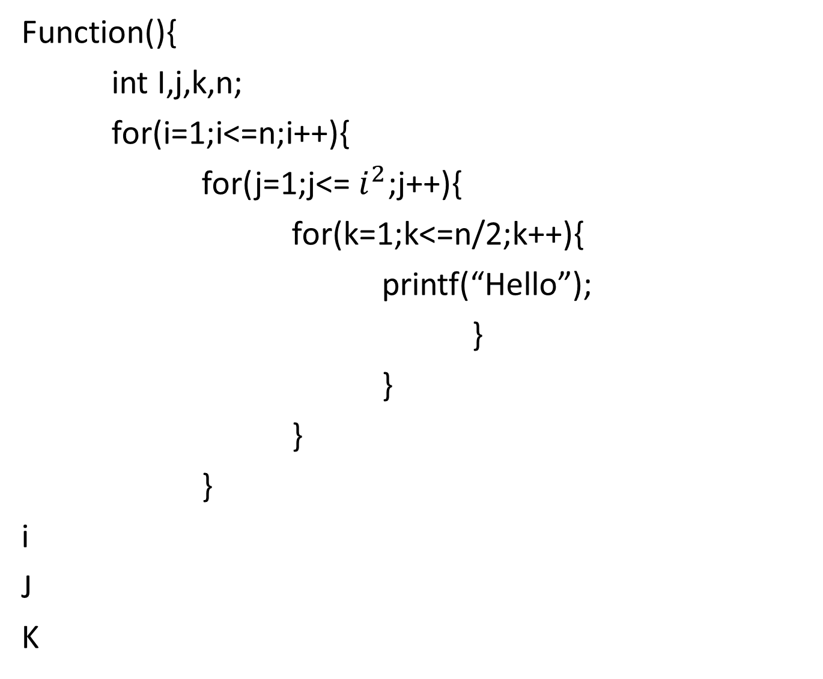
Function(){
int I,j,k,n;
for(i=1;i<=n;i++){
for(j=1;j<= $i^{2}$;j++){
for(k=1;k<=n/2;k++){
printf(“Hello”);
}
}
}
}
i
J
K

Slide 50

Function(){
int I,j,k,n;
for(i=1;i<=n;i++){
for(j=1;j<= $i^{2}$;j++){
for(k=1;k<=n/2;k++){
printf(“Hello”);
}
}
}
}
I 1
J
K

Slide 51

Function(){
int I,j,k,n;
for(i=1;i<=n;i++){
for(j=1;j<= $i^{2}$;j++){
for(k=1;k<=n/2;k++){
printf(“Hello”);
}
}
}
}
I 1
J 1
K

Slide 52

Function(){
int I,j,k,n;
for(i=1;i<=n;i++){
for(j=1;j<= $i^{2}$;j++){
for(k=1;k<=n/2;k++){
printf(“Hello”);
}
}
}
}
I 1
J 1
K 1*n/2

Slide 53

Function(){
int I,j,k,n;
for(i=1;i<=n;i++){
for(j=1;j<= $i^{2}$;j++){
for(k=1;k<=n/2;k++){
printf(“Hello”);
}
}
}
}
I 1 2
J 1
K 1*n/2

Slide 54

Function(){
int I,j,k,n;
for(i=1;i<=n;i++){
for(j=1;j<= $i^{2}$;j++){
for(k=1;k<=n/2;k++){
printf(“Hello”);
}
}
}
}
I 1 2
J 1 4
K 1*n/2

Slide 55

Function(){
int I,j,k,n;
for(i=1;i<=n;i++){
for(j=1;j<= $i^{2}$;j++){
for(k=1;k<=n/2;k++){
printf(“Hello”);
}
}
}
}
I 1 2
J 1 4
K 1*n/2 4*n/2

Slide 56

Function(){
int I,j,k,n;
for(i=1;i<=n;i++){
for(j=1;j<= $i^{2}$;j++){
for(k=1;k<=n/2;k++){
printf(“Hello”);
}
}
}
}
I 1 2 3
J 1 4
K 1*n/2 4*n/2

Slide 57

Function(){
int I,j,k,n;
for(i=1;i<=n;i++){
for(j=1;j<= $i^{2}$;j++){
for(k=1;k<=n/2;k++){
printf(“Hello”);
}
}
}
}
I 1 2 3
J 1 4 9
K 1*n/2 4*n/2

Slide 58

Function(){
int I,j,k,n;
for(i=1;i<=n;i++){
for(j=1;j<= $i^{2}$;j++){
for(k=1;k<=n/2;k++){
printf(“Hello”);
}
}
}
}
I 1 2 3
J 1 4 9
K 1*n/2 4*n/2 9*n/2

Slide 59

Function(){
int I,j,k,n;
for(i=1;i<=n;i++){
for(j=1;j<= $i^{2}$;j++){
for(k=1;k<=n/2;k++){
printf(“Hello”);
}
}
}
}
I 1 2 3 4
J 1 4 9
K 1*n/2 4*n/2 9*n/2

Slide 60

Function(){
int I,j,k,n;
for(i=1;i<=n;i++){
for(j=1;j<= $i^{2}$;j++){
for(k=1;k<=n/2;k++){
printf(“Hello”);
}
}
}
}
I 1 2 3 4
J 1 4 9 16
K 1*n/2 4*n/2 9*n/2

Slide 61

Function(){
int I,j,k,n;
for(i=1;i<=n;i++){
for(j=1;j<= $i^{2}$;j++){
for(k=1;k<=n/2;k++){
printf(“Hello”);
}
}
}
}
I 1 2 3 4
J 1 4 9 16
K 1*n/2 4*n/2 9*n/2 16*n/2

Slide 62

Function(){
int I,j,k,n;
for(i=1;i<=n;i++){
for(j=1;j<= $i^{2}$;j++){
for(k=1;k<=n/2;k++){
printf(“Hello”);
}
}
}
}
I 1 2 3 4 5
J 1 4 9 16
K 1*n/2 4*n/2 9*n/2 16*n/2

Slide 63

Function(){
int I,j,k,n;
for(i=1;i<=n;i++){
for(j=1;j<= $i^{2}$;j++){
for(k=1;k<=n/2;k++){
printf(“Hello”);
}
}
}
}
I 1 2 3 4 5
J 1 4 9 16 25
K 1*n/2 4*n/2 9*n/2 16*n/2 25*n/2

Slide 64
Function(){
int I,j,k,n;
for(i=1;i<=n;i++){
for(j=1;j<= $i^{2}$;j++){
for(k=1;k<=n/2;k++){
printf(“Hello”);
}
}
}
}
I 1 2 3 4 5
J 1 4 9 16 25
K 1*n/2 4*n/2 9*n/2 16*n/2 25*n/2

Slide 65

Function(){
int I,j,k,n;
for(i=1;i<=n;i++){
for(j=1;j<= $i^{2}$;j++){
for(k=1;k<=n/2;k++){
printf(“Hello”);
}
}
}
}
I 1 2 3 4 5…………………….n
J 1 4 9 16 25
K 1*n/2 4*n/2 9*n/2 16*n/2 25*n/2

Slide 66

Function(){
int I,j,k,n;
for(i=1;i<=n;i++){
for(j=1;j<= $i^{2}$;j++){
for(k=1;k<=n/2;k++){
printf(“Hello”);
}
}
}
}
I 1 2 3 4 5…………………….n
J 1 4 9 16 25…………………..n²
K 1*n/2 4*n/2 9*n/2 16*n/2 25*n/2

Slide 67

Function(){
int I,j,k,n;
for(i=1;i<=n;i++){
for(j=1;j<= $i^{2}$;j++){
for(k=1;k<=n/2;k++){
printf(“Hello”);
}
}
}
}
I 1 2 3 4 5…………………….n
J 1 4 9 16 25…………………..n²
K 1*n/2 4*n/2 9*n/2 16*n/2 25*n/2…………..n²*n/2

Slide 68

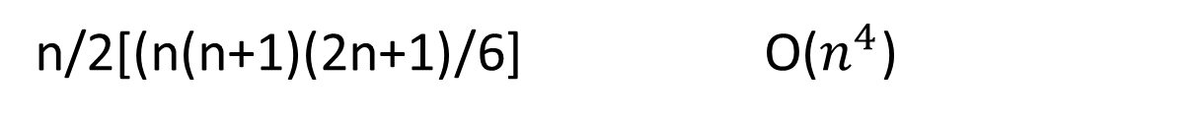
Function(){
int I,j,k,n;
for(i=1;i<=n;i++){
for(j=1;j<= $i^{2}$;j++){
for(k=1;k<=n/2;k++){
printf(“Hello”);
}
}
}
}
I 1 2 3 4 5…………………….n
J 1 4 9 16 25………………….. $n^{2}$
K 1*n/2 4*n/2 9*n/2 16*n/2 25*n/2…………..$n^{2}$*n/2
1*n/2 4*n/2 9*n/2 16*n/2 25*n/2…………..n²*n/2
n/2(1+$1^{2}+2^{2}+3^{2}$+….. $n^{2}$)
n/2[(n(n+1)(2n+1)/6] O($n^{4}$)

Slide 69
Function(){
for(i=1;i<n;i=i*2)
printf(“hello”);
}

Slide 70
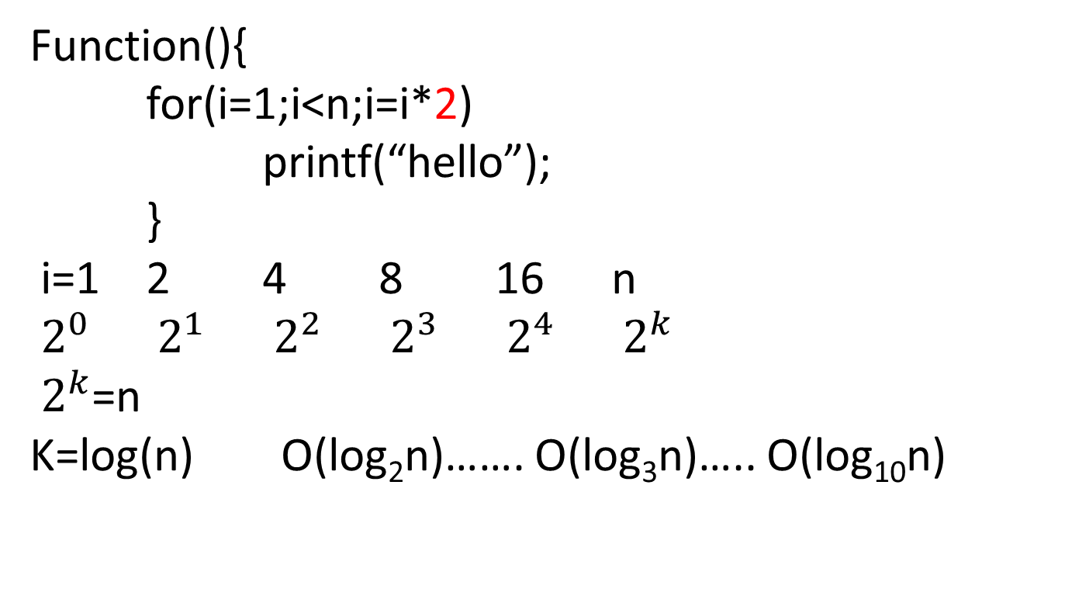
Function(){
for(i=1;i<n;i=i*2)
printf(“hello”);
}
i=1 2 4 8 16 n
$2^{0}$ $2^{1}$ $2^{2}$ $2^{3}$ $2^{4}$ $2^{k}$
$2^{k}$=n
K=log(n) O(log₂n)……. O(log₃n)….. O(log₁₀n)

Slide 71
Function(){
int i,j,k;
for(i=n/2;i<=n;i++) for(j=1;j<=n/2;j++) for(k=1;k<=n;k=k*2) printf(“hello”);
}

Slide 72
Function(){
int i,j,k;
for(i=n/2;i<=n;i++) …n/2
for(j=1;j<=n/2;j++) …n/2
for(k=1;k<=n;k=k*2) ... log₂n
printf(“hello”);
}
n/2 * n/2 * log₂n = O(n² log₂n)

Slide 73
Function(){
int I,j,k;
for(i=n/2;i<=n;i++) for(j=1;j<=n;j=2*j)
for(k=1;k<=n;k=k*2)
printf(“Hello”);
}

Slide 74
Function(){
int I,j,k;
for(i=n/2;i<=n;i++) for(j=1;j<=n;j=2*j)
for(k=1;k<=n;k=k*2)
printf(“Hello”);
}
= O(nlog²n)

Slide 75
Function(){
int i,j,k;
for(i=n/2;i<=n;i++) …n/2
for(j=1;j<=n/2;j++) …n/2
for(k=1;k<=n;k=k*2) ... log₂n
printf(“hello”);
}
n/2 * n/2 * log₂n = O(n² log₂n)

Slide 76
Function(){
for(i=1;i<=n,i++)
for(j=i;j<=n;j=j+i)
printf(“hello”);
}
I
J

Slide 77
Function(){
for(i=1;i<=n,i++)
for(j=I;j<=n;j=j+i)
printf(“hello”);
}
i=1 2 3 4
J=n n/2 n/3 n/4
n+n/2+n/3+……n/n)
n(1+1/2+1/3+1/4+……..1/n)
n(logn) => O(n logn)

Slide 78
Function()
{ while(n>1)
{ n=n/2
}
}

Slide 79
Function()
{ while(n>1)
{ n=n/2
}
}
Assume n>=2
n=2¹ – 1 time
n=2² – 2 times
n=2^{k} – k times
K=log₂n
O(log₂n)

Slide 80
Function()
{
int n=2^{2k}
for(i=1;i<=n;i++)
{
j=2;
while(j<=n)
{ j=j²
print (“Hello”)
}
}
}
?

Slide 81
Recursive Algorithms Analysis

Slide 82
Function(n){
if(n>1)
return(function(n-1))
}

Slide 83
Function(n){
if(n>1) T(1)
return(function(n-1))
}

Slide 84
Function(n){
if(n>1) T(1)
return(function(n-1)) T(n-1)
}

Slide 85
Function(n){
if(n>1) T(1)
return(function(n-1)) T(n-1)
}
T(n)=1+T(n-1) eq(1)

Slide 86
Function(n){
if(n>1) T(1)
return(function(n-1)) T(n-1)
}
T(n)=1+T(n-1) eq(1)
To find T(n-1) substitute n-1 to all n in eq(1)

Slide 87
Function(n){
if(n>1) T(1)
return(function(n-1)) T(n-1)
}
T(n)=1+T(n-1) eq(1)
To find T(n-1) substitute n-1 to all n in eq(1)
T(n-1)=1+T(n-2) eq(2)

Slide 88
Function(n){
if(n>1) T(1)
return(function(n-1)) T(n-1)
}
T(n)=1+T(n-1) eq(1)
To find T(n-1) substitute n-1 to all n in eq(1)
T(n-1)=1+T(n-2) eq(2)
To find T(n-2) substitute n-2 to all n in eq(1)

Slide 89
Function(n){
if(n>1) T(1)
return(function(n-1)) T(n-1)
}
T(n)=1+T(n-1) eq(1)
To find T(n-1) substitute n-1 to all n in eq(1)
T(n-1)=1+T(n-2) eq(2)
To find T(n-2) substitute n-2 to all n in eq(1)
T(n-2)=1+T(n-3) eq(3)

Slide 90
Function(n){
if(n>1) T(1)
return(function(n-1)) T(n-1)
}
T(n)=1+T(n-1) eq(1)
To find T(n-1) substitute n-1 to all n in eq(1)
T(n-1)=1+T(n-2) eq(2)
To find T(n-2) substitute n-2 to all n in eq(1)
T(n-2)=1+T(n-3) eq(3)
Backward substitution

Slide 91
Function(n){
if(n>1) T(1)
return(function(n-1)) T(n-1)
}
T(n)=1+T(n-1) eq(1)
To find T(n-1) substitute n-1 to all n in eq(1)
T(n-1)=1+T(n-2) eq(2)
To find T(n-2) substitute n-2 to all n in eq(1)
T(n-2)=1+T(n-3) eq(3)
Backward substitution
Substitute eq(2) in 1 T(n) = I+[1+T[n-2]] = 2+T[n-2]

Slide 92
Function(n){
if(n>1) T(1)
return(function(n-1)) T(n-1)
}
T(n)=1+T(n-1) eq(1)
To find T(n-1) substitute n-1 to all n in eq(1)
T(n-1)=1+T(n-2) eq(2)
To find T(n-2) substitute n-2 to all n in eq(1)
T(n-2)=1+T(n-3) eq(3)
Backward substitution
Substitute eq(2) in 1 T(n) = I+[1+T[n-2]] = 2+T[n-2]
Substitute eq(3) in 2 T(n)=2+[1+T[n-3]] = 3+T[n-3]

Slide 93
Function(n){
if(n>1) T(1)
return(function(n-1)) T(n-1)
}
T(n)=1+T(n-1) eq(1)
To find T(n-1) substitute n-1 to all n in eq(1)
T(n-1)=1+T(n-2) eq(2)
To find T(n-2) substitute n-2 to all n in eq(1)
T(n-2)=1+T(n-3) eq(3)
Backward substitution
Substitute eq(2) in 1 T(n) = I+[1+T[n-2]] = 2+T[n-2]
Substitute eq(3) in 2 T(n)=2+[1+T[n-3]] = 3+T[n-3]
K+T[n-k] eq(4)

Slide 94
Function(n){
if(n>1) T(1)
return(function(n-1)) T(n-1)
}
T(n)=1+T(n-1) eq(1)
To find T(n-1) substitute n-1 to all n in eq(1)
T(n-1)=1+T(n-2) eq(2)
To find T(n-2) substitute n-2 to all n in eq(1)
T(n-2)=1+T(n-3) eq(3)
Backward substitution
Substitute eq(2) in 1 T(n) = I+[1+T[n-2]] = 2+T[n-2]
Substitute eq(3) in 2 T(n)=2+[1+T[n-3]] = 3+T[n-3]
K+T[n-k] eq(4)
When n-k=1 loop stop so k=n-1 substitute in eq(4)

Slide 95
Function(n){
if(n>1) T(1)
return(function(n-1)) T(n-1)
}
T(n)=1+T(n-1) eq(1)
To find T(n-1) substitute n-1 to all n in eq(1)
T(n-1)=1+T(n-2) eq(2)
To find T(n-2) substitute n-2 to all n in eq(1)
T(n-2)=1+T(n-3) eq(3)
Backward substitution
Substitute eq(2) in 1 T(n) = I+[1+T[n-2]] = 2+T[n-2]
Substitute eq(3) in 2 T(n)=2+[1+T[n-3]] = 3+T[n-3]
K+T[n-k]
When n-k=1 loop stop so k=n-1 substitute in eq(4)
n-1+T[n-[n-1]]]

Slide 96
Function(n){
if(n>1) T(1)
return(function(n-1)) T(n-1)
}
T(n)=1+T(n-1) eq(1)
To find T(n-1) substitute n-1 to all n in eq(1)
T(n-1)=1+T(n-2) eq(2)
To find T(n-2) substitute n-2 to all n in eq(1)
T(n-2)=1+T(n-3) eq(3)
Backward substitution
Substitute eq(2) in 1 T(n) = I+[1+T[n-2]] = 2+T[n-2]
Substitute eq(3) in 2 T(n)=2+[1+T[n-3]] = 3+T[n-3]
K+T[n-k]
When n-k=1 loop stop so k=n-1 substitute in eq(4)
n-1+T[n-[n-1]]]
n

Slide 97
Function(n){
if(n>1) T(1)
return(function(n-1)) T(n-1)
}
T(n)=1+T(n-1) eq(1)
To find T(n-1) substitute n-1 to all n in eq(1)
T(n-1)=1+T(n-2) eq(2)
To find T(n-2) substitute n-2 to all n in eq(1)
T(n-2)=1+T(n-3) eq(3)
Backward substitution
Substitute eq(2) in 1 T(n) = I+[1+T[n-2]] = 2+T[n-2]
Substitute eq(3) in 2 T(n)=2+[1+T[n-3]] = 3+T[n-3]
K+T[n-k]
When n-k=1 loop stop so k=n-1 substitute in eq(4)
n-1+T[n-[n-1]]]
n
O(n)

Slide 98
T(n)=n+T(n-1)

Slide 99
Algorithms for computing the Factorial
int factorial (int n)
{
if (n<=1)
return 1;
else {
fact = 1;
for (k=2; k<=n; k++)
fact =fact* k;
return fact;
}
}
int factorial (int n)
{
If (n <= 1)
return 1;
else
return n * factorial(n-1);
}

Slide 100
Master Theorem
Let T(n) be a monotonically increasing function that satisfies
T(n) = a T(n/b) + f(n)
T(1) = c
where a ≥ 1, b ≥ 2, c>0. If f(n) is Θ(n^{d}) where d ≥ 0 then
 |  | if a < b^{d}
T(n) = |  | If a = b^{d}
 |  | if a > b^{d}

Slide 101
Review: Analysis of Merge Sort
Statement Effort
So T(n) = Θ(1) when n = 1, and 2T(n/2) + Θ(n) when n > 1
This expression is a recurrence
MergeSort(A, left, right) { T(n)
if (left < right) { Θ(1)
mid = floor((left + right) / 2); Θ(1)
MergeSort(A, left, mid); T(n/2)
MergeSort(A, mid+1, right); T(n/2)
Merge(A, left, mid, right); Θ(n)
}
}

Slide 102
Master Theorem: Example 1
Let T(n) = T(n/2) + ½ n² + n. What are the parameters?
a =
b =
d =
Therefore, which condition applies?
1
2
2
1 < 2², case 1 applies
We conclude that
T(n) ∈ Θ(n^{d}) = Θ (n²)

Slide 103
Master Theorem: Example 2
Let T(n)= 2 T(n/4) + √n + 42. What are the parameters?
a =
b =
d =
Therefore, which condition applies?
2
4
1/2
2 = 4^{1/2}, case 2 applies
We conclude that

Slide 104
Master Theorem: Example 3
Let T(n)= 3 T(n/2) + 3/4n + 1. What are the parameters?
a =
b =
d =
Therefore, which condition applies?
3
2
1
3 > 2¹, case 3 applies
We conclude that

